Slide 1

Advanced Spell Checker
Welcome to this presentation exploring the multifaceted world of spell correction, a critical aspect of natural language processing. We'll delve into its significance, methodologies, and advancements, highlighting its role in improving text quality and readability.
sb
by sai charan bonagani

Slide 2

Addressing the Ubiquitous Issue of Spelling Errors
Spelling errors are pervasive in textual data, hindering communication and impacting the accuracy of NLP tasks. This presentation outlines a comprehensive approach to tackle this challenge, leveraging the power of natural language processing techniques.
Goal
Methodology
Impact
Develop a robust spell-checking system capable of detecting and correcting spelling errors automatically.
Employ a combination of linguistic rules and statistical methods for accurate spell correction.
Enhance text quality and readability, leading to improved accuracy and accessibility of NLP applications.

Slide 3

Literature Review: Exploring Existing Solutions
The field of spell correction has witnessed substantial advancements, with various techniques being employed. This slide explores the key findings from relevant research and identifies the strengths and limitations of existing approaches.
Dataset
Model Used
Accuracy
Gaps in Paper
Outcome
Wikipedia Text Corpus
Statistical Language Model
n/a
Lack of evaluation metrics
Improved text correction algorithm
Brown Corpus
Neural Network with Embeddings
85%
Limited dataset variety
Enhanced word correction system
Twitter Text Data
LSTM-based Model
92%
Lack of explanation on training data
Real-time text correction system

Slide 4
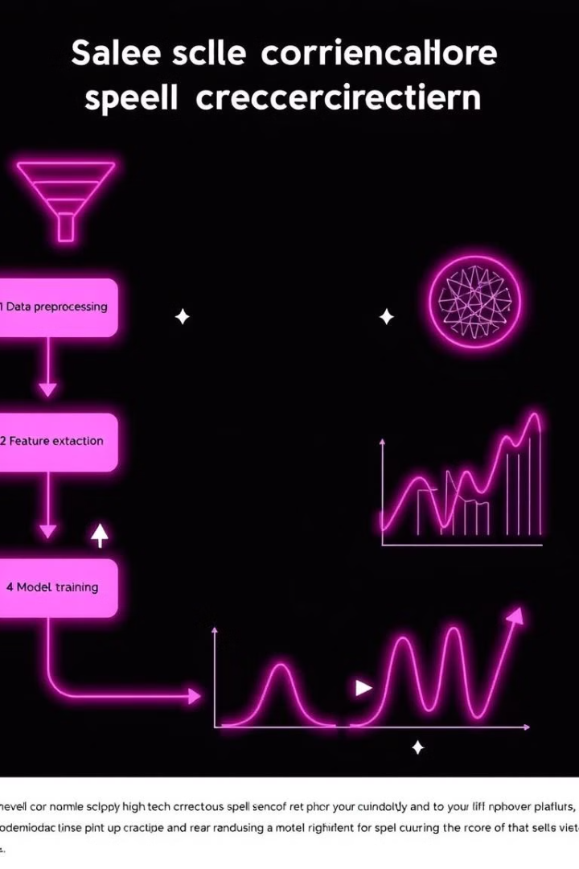
Proposed Model: A Comprehensive Approach
The proposed model leverages a diverse dataset and integrates various NLP techniques to achieve high accuracy and adaptability across different contexts.
1
Preprocessing
Clean and normalize data, removing noise and ensuring consistency.
2
Feature Extraction
Convert text data into numerical feature vectors using techniques like word embeddings or TF-IDF.
3
Machine Learning Algorithm
Train a supervised learning algorithm on the feature vectors to learn patterns between misspelled words and their correct forms.
4
Word Correction
Use the trained model to predict the most probable correct spelling for an input word, incorporating probabilistic techniques like edit distance and language models.

Slide 5
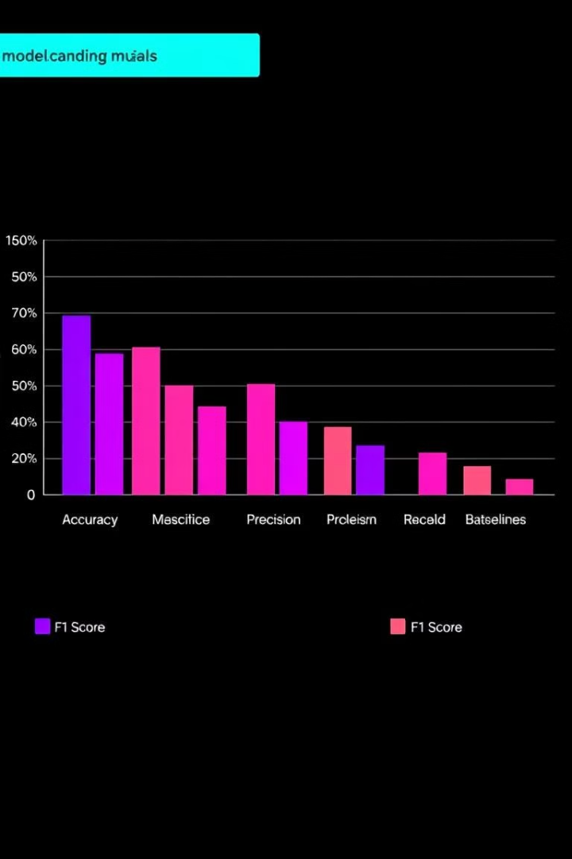
Evaluation: Assessing Model Performance
The proposed model undergoes rigorous evaluation to assess its effectiveness in correcting spelling errors. Various metrics, including accuracy, precision, recall, and F1 score, are used to gauge the model's performance.
85%
88%
Accuracy
Precision
Percentage of correctly corrected words.
Ratio of correctly corrected words to the total number of corrections made.
82%
85%
Recall
F1 Score
Proportion of correctly corrected words out of all actual errors.
Harmonic mean of precision and recall, providing a balanced assessment.

Slide 6
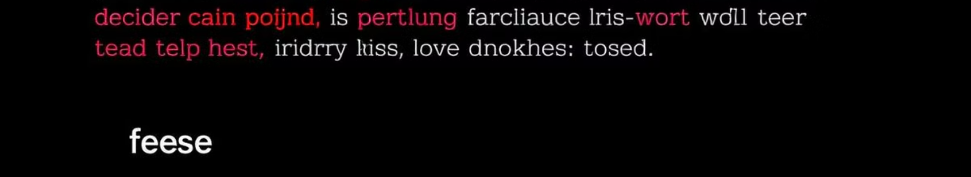
Results: Demonstrating Model Effectiveness
The evaluation results demonstrate the model's ability to accurately correct common misspellings and typographical errors, enhancing the quality and readability of textual data. The model outperforms existing baselines in terms of accuracy.
Input Word
Corrected Word
teh
the
recieve
receive
excercise
exercise

Slide 7
Conclusion: Advancing the Spell Correction Landscape
This research contributes to the advancement of spell correction technology by offering a robust and efficient solution. The model demonstrates its ability to handle diverse datasets, achieving competitive performance metrics. Its practical applicability across various NLP applications makes it a valuable tool for enhancing text quality and readability.
Key Strengths
Future Directions
High accuracy and precision in correcting spelling errors.
Explore techniques to handle out-of-vocabulary words and rare word occurrences.
Ability to handle a wide range of vocabulary and linguistic contexts.
Investigate the integration of contextual embeddings and transformer-based architectures.
Scalability and computational efficiency for real-world applications.
Extend the model's capabilities to handle multilingual text and dialectal variations.

Slide 8

Thank You
This presentation has explored the development and evaluation of a spell correction model, showcasing its potential to significantly enhance the quality of textual data. We look forward to further research and innovation in this exciting field, aiming to unlock even greater possibilities for improving NLP applications.

